Slide 1
Programming in C

Slide 2
Week 7
Pointers and Arrays

Slide 3

Wrap up: Pointers
int c;
int *p; /* declare a pointer */
p = &c; /* assign the address of c to p */
*p = 5; /* dereferencing the pointer p */

Slide 4
Debugging challenge
Team-up with a classmate
Download starting code from canvas: debuggingChallenge.rar
Perform the challenge as described in the starting code
Will you be the first team to debug the program?

Slide 5

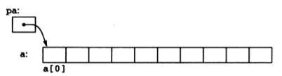
Pointers and Arrays
int a[10];
int *pa;
pa = &a[0];

Slide 6
Pointers and Arrays
int a[5] = {2, 4, 5, 8, 1}; int *pa = a; // same as : int *pa = &a[0]; int x = *pa; // same as : int x = a[0];
MEMORY | ADDRESS | pa | pa+1 | pa+2 | pa+3 | pa+4
 |  | &a[0] | &a[1] | &a[2] | &a[3] | &a[4]
 |  | 200 | 204 | 208 | 212 | 216
 | VALUE | 2 | 4 | 5 | 8 | 1
 |  | a[0] | a[1] | a[2] | a[3] | a[4]
 |  | *pa | *(pa+1) | *(pa+2) | *(pa+3) | *(pa+4)
Pointer arithmetic
Array indexing
Array indexing
Pointer arithmetic

Slide 7
Quiz
Given:
int a[6] = { 3, 6, -3, 1, 8, 3 };
int i = 3, j = 8;
int* p = a;
int* q;
int* r = &a[1];
Find the result of the following operations:
i = *(p + 5);
j = sizeof (a);
r[2] = p[2] + a[1];
*q += (*p )* (*r);
Operation | Result
i = *(p+5)
j = sizeof(a)
r[2] = p[2] + a[1]
*q += (*p)*(*r)
i = 3
j = 24
r[2] = 3
*q does not point to any data

Slide 8
Pointers and arrays
int sumOfElements(int a[ ], int size)
{
int sum = 0;
for (int i = 0; i < size; i++)
{
sum += a[i];
}
return sum;
}
int main()
{
int a[] = {1,2,3,4,5};
int sum = sumOfElements(a, 5);
printf(“Sum of elements is %d\n”, sum);
}
int sumOfElements(int *a, int size)
{
int sum = 0;
for (int i = 0; i < size; i++)
{
sum += *a;
a++;
}
return sum;
}
int main()
{
int a[] = {1,2,3,4,5};
int size = sizeof(a)/sizeof(a[0]);
int sum = sumOfElements(a, size);
printf(“Sum of elements is %d\n”, sum);
}
Array indexing
Pointer arithmetic
What is the advantage of using pointer arithmetic over array indexing?

Slide 9
Exercise 1
Function name | search_value
Description | The function checks if an array contains a specified value.
Possible prototype | bool search_value(int* array, int size_array, int value, bool* result)

Slide 10
Exercise 2
Function name | calc_occurrence
Description | The function calculates the occurrence of a specified value in an array. The occurrence is calculated as a percentage.
Possible prototype | bool calc_occurence(int* array, int size_array, int value, float* occurence)

Slide 11
Exercise 3
Function name | reverse_order
Description | The function reverses the order of elements in an array. Hint: can you re-use the swap function of the debugging challenge ?
Possible prototype | bool reverse_order(int* array, int size_array)

Slide 12
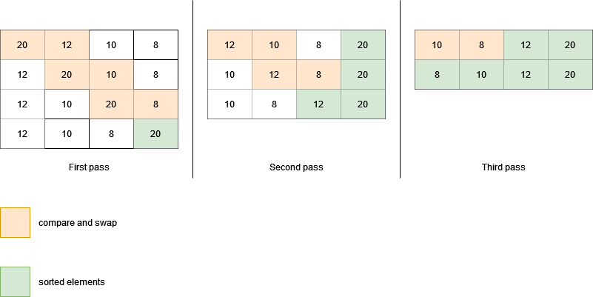
Sorting arrays: “bubble sort” algorithm

Slide 13
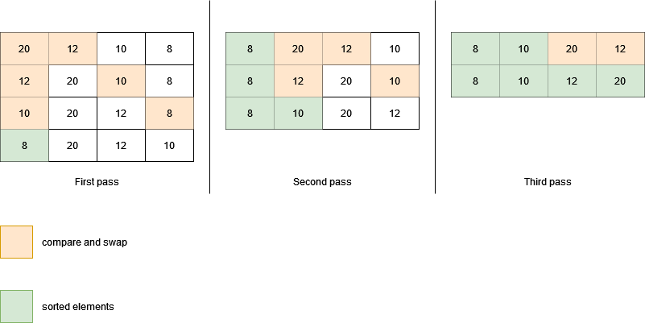
Sorting arrays: “exchange sort” algorithm

Slide 14
Exercise 4
Function name | bubble_sort
Description | The function sorts an array using the bubble sort algorithm.
Possible prototype | bool bubble_sort(int* array, int size_array)

Slide 15
Exercise 5
Function name | exchange_sort
Description | The function sorts an array using the exchange sort algorithm.
Possible prototype | bool exchange_sort(int* array, int size_array)

Slide 16
Pointers and strings (array of characters)
Strings are basically arrays of characters
char c1[6] = “Hello”;
char *c2;
c2 = c1; // c2[i] is *(c2 + i)
c1 = c2; X
c1 = c1 + 1; X
c2++; Y
200
201
202
c1
H | e | l | l | o | \0
c2
200

Slide 17
Pointers and strings (array of characters)
char s1[12];
char s2[] = “how are you”;
char *s3 =“today?...”
char s4[20] = “result”;
char *s5;
s5 = s4;
//Length of string s4?
int i = 0;
while (*(s4+i) != '\0') {
i++;
}
printf (“Word %s has %d characters\n" , s4, i);
Quiz:
1. Is s4 = s5 valid?
2. Is s4++ valid?
3. Is s5++ valid?
4. Is s5[2] valid?
5. Is s4[2] valid?
6. Is *(s4+2) valid?
7. Is *(s5+2) valid?
200 | 201 | 202 | 203 | 204 | 205 | 206
r | e | s | u | l | t | \0
s4
s5
200
400

Slide 18
Passing string to function
#include <stdio.h>
#include <string.h>
void print(char c[])
{
int i = 0;
while(c[i] != ‘\0’)
{
printf(“%c”,c[i]);
i++;
}
printf(“\n”);
}
int main()
{
char c[20] = “Hello”;
print(c);
}
#include <stdio.h>
#include <string.h>
void print(char *c)
{
while(*c != ‘\0’)
{
printf(“%c”, *c);
c++;
}
printf(“\n”);
}
int main()
{
char c[20] = “Hello”;
print(c);
}
#include <stdio.h>
#include <string.h>
void print(char *c)
{
while(*c != ‘\0’)
{
printf(“%c”, *c);
c++;
}
printf(“\n”);
}
int main()
{
char *c = “Hello”;
print(c);
}

